Slide 1

IKARUS
Data Integration and Visualization Project
IOANNIS POLYMENAKOS

Slide 2




INTRODUCTION
Overview of the Project:
Purpose: To collect, store, and visualize Greek flights data.
TOOL USAGE
API
Python
Oracle DB
Power Bi

Slide 3

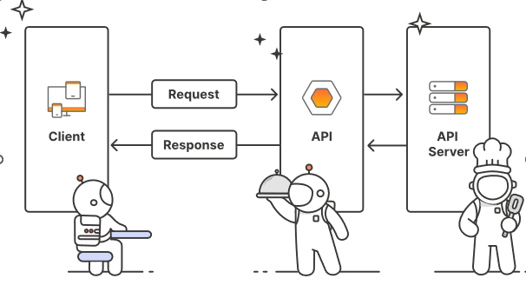
What is an API ?
API stands for Application Programming Interface. It is a set of rules that allows different software applications to communicate with each other.
Components:
Endpoints: URLs where API services are accessed.
Methods: Types of requests (e.g., GET, POST, DELETE).
API Key is a unique identifier used to authenticate when making requests to an API.
Requests: Data sent to the API to perform an action or retrieve information.
Responses: Data returned by the API, often in formats like JSON or XML.
Benefits:
Reusability: APIs provide reusable building blocks for developers.
Interoperability: Enable different systems and applications to work together.

Slide 4

APIS in Our Project
Overview: How APIs are utilized to gather flight data.
API 1:
Source: (Sky Scanner)
Url: https://skyscanner80.p.rapidapi.com/api/v1/flights/search-everywhere
Data provide: Returns detailed flight information including prices, airlines.
API 2:
Source: (FlightRadar24)
Url: https://flightradar243.p.rapidapi.com/v1/airports/disruptions
Data provide: Provides access to flight data, flight delays and Airports locations.

Slide 5

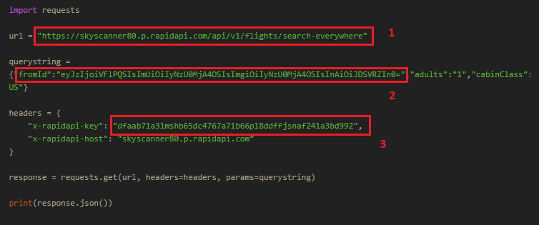
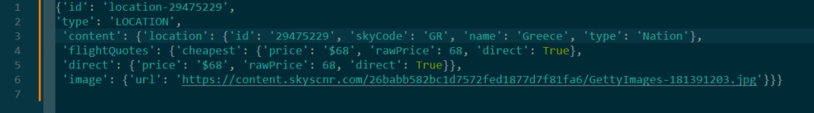
API Data Collection Process
.
In this step we used Python (3.12.0 version) and Python IDE PyCharm (2024.1.1 version)
import requests:
Python library used to send HTTP requests. In this case, it is used to send a GET request to the Skyscanner API.
1. Url = https://skyscanner80.p.rapidapi.com/api/v1/flights/search-everywhere
Holds the endpoint for the Skyscanner API that allows searching for flights from a specific location to various destinations
2. Querystring =
Contains parameters to be sent with the GET request.(Airport, cabin class)
3. API key = "dfaab71a31mshb65dc4767a71b66p18ddffjsnaf241a3bd992"
The API key required for authentication.

Slide 6



Handling API Data
.
Diagram of Python Script to Fetch data from API and stored to Oracle Database.
Libraries
import requests
import cx_Oracle
Initial Setup
API request
Database Connection Details
DSN and connection setup
Insert query to Oracle tables
Final Steps
Commit transaction
Close connection

Slide 7





Storing Tables in oracle:
From Sky Scanner API:
Airports
Flights From Greek Airports Final
Flight Radar Airport Info
Flight Radar Airport Stats
From FlightRadar24 API:
In this step we used Oracle Database (21c version) and Oracle SQL Developer (23.1.1.345 version).

Slide 8


Visualizing API Data in Power BI
.
In this final step, we connected the Power BI application with the database with Oracle Database connector.
Once we load the four tables, we transform and we create the data model.
Creating Interactive Dashboards and KPIs.

Slide 9

Thank You Team!

